Slide 1
Discrete Structure/Mathematics BSCS (3 Credit Hour)
Lecture # 01

Slide 2
Introduction
Discrete structures/mathematics has special relevance to computer science.
Computer is a binary machine and all the algorithms in computer science are based on binary digits 0 and 1. We therefore can say computer is inherently is DISCRETE.

Slide 3
Application of Discrete Structure
Apart from computer sc. Discrete Structure have application in many diverse areas.
Example:
Management Science
Network Analysis
Social decision making
Finance

Slide 4
Reasons to study discrete Mathematics.
Mathematical Maturity essential to study any scientific discipline.
Prerequisite of number of advance courses i.e.
Data Structures
Algorithm Analysis
Theory of Automata
Computer Theory

Slide 5
The kind of problem solved using Discrete Structure Course:
How many ways are there to choose a valid password?
Is there a path connecting two computers in a network?
How can a circuit that adds two integers be designed?
How many valid internet addresses are there?
How can we encrypt credit card information on the web?
What is the probability of winning a lottery?

Slide 6
Recommended Books:
Discrete Mathematics and its application by Kenneth H. Rosen, 7th edition.
Discrete Mathematics with applications by Susanna S. Epp.
Discrete Mathematics by Ross and Wright

Slide 7
Instructor Email Address:
tahseen.fatima1@cs.uol.edu.pk

Slide 8
Main Topics:
Logic
Sets & Operations on sets
Relations & Their Properties
Functions
Sequences & Series
Recurrence Relations
Mathematical Induction
Combinatorics
Probability
11. Graphs and Trees

Slide 9
Marks Distribution
Assignments + Attendance (5 + 5%)
Quiz (10 %)
Midterm Exam (30 %)
During the 8th week.
Duration: 1.5 hour.
Will cover all material covered during the first seven weeks.
Final Exam (50 %)
During the 16th week.
Will cover whole of the course with a slight emphasis on the material cover after the midterm exam.
Duration: 1.5 hour

Slide 10
What is Discrete mathematics / structures?
The word discrete is essentially the opposite of continuous, discontinuous or segregated.
Definition:
“Discrete Mathematics/Structure concerns processes that consist of a sequence of individual steps.”

Slide 11
Example:
Discrete
Continuous

Slide 12
Example:
Set of Integers:
• • • • • •
3 -2 -1 0 1 2
Set of Real Numbers:
• • • • • • •
-3 -2 -1 0 1 2 3

Slide 13
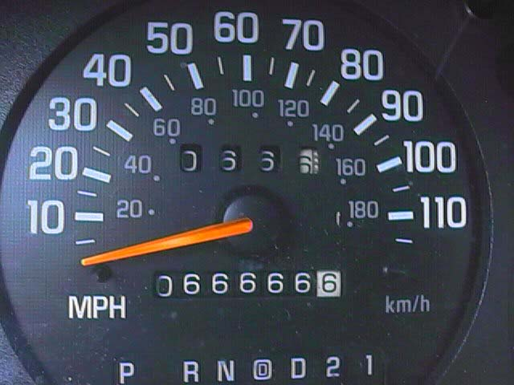
Odometer

Slide 14
Logic
Logic rules and principles is to distinguish an argument is valid or invalid.
Def:
“Logic is the study of the principles and methods that distinguishes between a valid and an invalid argument.”

Slide 15
PROPOSITION
A statement/proposition is a declarative sentence which is either TRUE or FALSE but not both.
A statement is also referred to as Proposition.
Example:
2+2 = 4
It is Sunday today
If a proposition is true, we say that it has a truth value of "true”.
If a proposition is false, its truth value is "false".
The truth values “true” and “false” are, respectively, denoted by the letters T and F.

Slide 16
Examples:
Statement Truth Value
Grass is green.
4 + 2 = 6
4 + 2 = 7
There are four fingers in a hand.

Slide 17
Examples:
Statement Truth Value
Grass is green. T
4 + 2 = 6 T
4 + 2 = 7 F
There are four fingers in a hand. F

Slide 18
NOT Propositions
Close the door.
x is greater than 2.
He is very rich (though is a declarative statement but we don’t know about pronoun he)

Slide 19
Rule:
If the sentence is preceded by other sentences that make the pronoun or variable reference clear, then the sentence is a statement.
Example
Bill Gates is an American
He is very rich
He is very rich is a statement with truth-value TRUE.

Slide 20
Example:
x = 1
x > 2
x > 2 is a statement with truth-value FALSE.

Slide 21
UNDERSTANDING STATEMENTS
x + 2 is positive.
May I come in?
Logic is interesting.
It is hot today.
-1 > 0
x + y = 12

Slide 22
UNDERSTANDING STATEMENTS
x + 2 is positive. Not a statement
May I come in? Not a statement
Logic is interesting. A statement
It is hot today. A statement
-1 > 0 A statement
x + y = 12 Not a statement

Slide 23
COMPOUND STATEMENT
Def:
“Simple statements could be used to build a compound statement.”
Examples:
“3 + 2 = 5” and “Lahore is a city in Pakistan”
“The grass is green” or “ It is hot today”
“Discrete Structure is not difficult to me”
AND, OR, NOT are called LOGICAL CONNECTIVES.

Slide 24
SYMBOLIC REPRESENTATION
Statements are symbolically represented by letters such as p, q, r,...
EXAMPLES:
p = “Islamabad is the capital of Pakistan”
q = “17 is divisible by 3”

Slide 25
LOGICAL CONNECTIVES
CONNECTIV | MEANING | SYMBOL | CALLED
Negation | not | ~ | Tilde
Conjunction | and | ∧ | Hat
Disjunction | or | ∨ | Vel
Conditional | if…then… | → | Arrow
Biconditional | if and only if | ↔ | Double arrow

Slide 26
EXAMPLES:
p = “Islamabad is the capital of Pakistan”
q = “17 is divisible by 3”
p ∧ q = ?
p ∨ q = ?
~p = ?

Slide 27
EXAMPLES:
p = “Islamabad is the capital of Pakistan”
q = “17 is divisible by 3”
p ∧ q = “Islamabad is the capital of Pakistan and 17 is divisible by 3”
p ∨ q = “Islamabad is the capital of Pakistan or 17 is divisible by 3”
~p = “It is not the case that Islamabad is the capital of Pakistan” or simply “Islamabad is not the capital of Pakistan”

Slide 28
TRANSLATING FROM ENGLISH TO SYMBOLS:
Let p = “It is hot”, and q = “It is sunny”
SENTENCE SYMBOLIC FORM
It is not hot.
It is hot and sunny.
It is hot or sunny.
It is not hot but sunny.
It is neither hot nor sunny.

Slide 29
TRANSLATING FROM ENGLISH TO SYMBOLS:
Let p = “It is hot”, and q = “It is sunny”
SENTENCE SYMBOLIC FORM
It is not hot. ~ p
It is hot and sunny. p ∧ q
It is hot or sunny. p ∨ q
It is not hot but sunny. ~ p ∧ q
It is neither hot nor sunny. ~ p ∧ ~ q

Slide 30
EXAMPLE:
Let h = “Ali is healthy”
w = “Ali is wealthy”
s = “Ali is wise”
SENTENCE SYMBOLIC FORM
Ali is healthy and wealthy but not wise.
Ali is not wealthy but he is healthy and wise.
Ali is neither healthy, wealthy nor wise.

Slide 31
EXAMPLE:
Let h = “Ali is healthy”
w = “Ali is wealthy”
s = “Ali is wise”
SENTENCE SYMBOLIC FORM
Ali is healthy and wealthy but not wise. (h ∧ w) ∧ (~s)
Ali is not wealthy but he is healthy and wise. ~w ∧ (h ∧ s)
Ali is neither healthy, wealthy nor wise. ~h ∧ ~w ∧ ~s

Slide 32
TRANSLATING FROM SYMBOLS TO ENGLISH
Let m = “Ali is good in Mathematics”
c = “Ali is a Computer Science student”
SYMBOLIC FORM STATEMENTS
~ c
c ∨ m
m ∧ ~c

Slide 33
TRANSLATING FROM SYMBOLS TO ENGLISH
Let m = “Ali is good in Mathematics”
c = “Ali is a Computer Science student”
SYMBOLIC FORM STATEMENTS
~ c Ali is not a Computer Science student
c ∨ m Ali is a Computer Science student or good in Math's
m ∧ ~c Ali is good in Math's but not a Computer Science student

Slide 34
TRUTH TABLE
A convenient method for analyzing a compound statement is to make a truth table for it.
A truth table specifies the truth value of a compound proposition for all possible truth values of its constituent propositions.

Slide 35
NEGATION (~)
If p is a statement variable, then negation of p, “not p”, is denoted as “~p”
It has opposite truth value from p i.e.,
if p is true, ~p is false; if p is false, ~p is true.

Slide 36
TRUTH TABLE FOR ~p
p | ~ p
T | F
F | T

Slide 37
CONJUCTION (∧)
If p and q are statements, then the conjunction of p and q is “p and q”, denoted as “p ∧ q”.
It is true when, and only when, both p and q are true. If either p or q is false, or if both are false, p ∧ q is false.

Slide 38
TRUTH TABLE FOR (p ∧ q)
p | q | p ∧ q
T | T | T
T | F | F
F | T | F
F | F | F

Slide 39
DISJUNCTION (∨)
If p & q are statements, then the disjunction of p and q is “p or q”, denoted as “p ∨ q”.
It is true when at least one of p or q is true and is false only when both p and q are false.

Slide 40
TRUTH TABLE FOR (p ∨ q)
p | q | p ∨ q
T | T | T
T | F | T
F | T | T
F | F | F

